Slide 1
Staff Development and Support
determining staffing needs; attracting, developing and supporting field-based staff, cultivating teams and team building
Alabama Provider Transformation Workshop
March 3, 2020
Genni Sasnett
National Subject Matter Expert

Slide 2
“If you “If you thought you were nothing without your staff before, you haven’t seen anything yet”
Staff - Our Most Important Asset

Slide 3
Reframing Staff as Change Agents
We are involved in a civil rights movement for people with disabilities
Civil rights laws, like ADA, often precede cultural change
Cultural change occurs slowly and begins with changes in entrenched perceptions
Changes in perception occur with changes in experience or observation
Staff are in a great position to effect those changes in perception through their behavior and advocacy

Slide 4
Determining Staffing Needs
Piloting
trying things out to determine staffing ratios and types
Scaling
planning for growing the service
Deploying
distributing manpower
Forecasting
estimating need based on experience

Slide 5
Staff Recruitment That Works!
Job descriptions - reflect new roles and responsibilities
Recruitment strategies focus on qualities and characteristics
Interview process accurately Identifies the correct staff for the job
New staff provided with effective training and mentoring
Notes:
GO TO MANUAL AND RELATED HANDOUTS - As the roles and responsibilities of staff began to change understood that staff recruitment had to be different. Roles and responsibilities were broader. More direct contact with public. Greater need to make independent decisions. Much greater role as advocates for individuals they supported. Increased responsibility as role models for appropriate community social interactions. Ambassadors for the mission and vision of the agency. Negotiators, educators in addition to the specialized skills associated with assisting people to gain and maintain employment and find ways to make meaningful contributions to their communities.
Qualities and characteristics
Self directed
Strong personal work ethic
Communication skills and ability to articulate mission and vision of agency
Decision-making ability
Crisis management
Personal presentation
Negotiation/compromise
Advocacy
Teaching and training in functional settings
Recruitment strategies
Individuals involved in interviews
Internet – referrals
Identifying the right person for the job
Experience – but not always going to find folks with CB skills
Hobbies
Community connections – bridge building skills
Questions regarding beliefs and opinions – what should we be trying to achieve
Former Facility based staff –
Many, many made the change and are advocates for community now
Some could not or choose not to make the change – had to be ok with that, just no longer a good match and they can choose to move along, no hard feelings – but they must either buy in or drop out – no middle ground

Slide 6
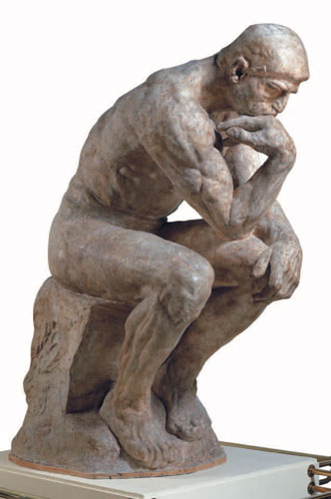
Deciding What You Need in Staff
Skills and Competencies
APSE/CESP https://vimeo.com/226478025
ACRE http://www.acreducators.org/competencies
ODEP Customized Employment https://www.dol.gov/odep/pdf/2011cecm.pdf
Qualities and Characteristics
Critically important in community work. Should be woven into everything – starting with job descriptions
Notes:
Karen: discuss the difference between competency based versus time based training. Statistic: 75% people in PA are doing CESP
We don’t want people who have done this job for a long time just because they have done this for a long time, we want people who can do the job. Stop and think about what that looks like. Use some of the competency models that already exist.

Slide 7
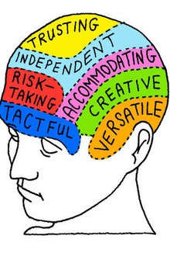
Identifying Staff Qualities and Characteristics
Community connected
Great communication skills, especially listening
Professional appearance and presentation
Self-directed and organized
Good decision making skills
Self starter
Problem solver
Negotiator
Crisis management skills
Innovative
Strong personal work ethic
Committed advocate
Use of “teachable moments”
Understanding of how to provide support from “behind the scenes”

Slide 8
Include mission and values
Write job summary – using words that reflect duties & values
Highlight work in the community
Stipulate need for good teamwork & flexibility

Slide 9
Sample from Job Description Job Summary
Works with assigned individuals, staff and circles of support to identify the job seekers interests, skills, talents and possible support needs to facilitate community integrated employment.
Works with community employers to gain an understanding of the overall functioning and personnel needs of their businesses.
Makes sound matches between the work aspirations and skills of people supported and the personnel needs of employers, which result in satisfactory outcomes for both parties.
Notes:
Karen and Genni:
Tailor your job descriptions to the job, that way you can use them when it come to support and evaluation. People stay at jobs when they feel confident and competent. Knowing what their job is, is the beginning of that.

Slide 10
Recruitment Writing a job posting that attracts the right people
Values are key in our work – express the agency’s values in the recruitment process by:
Thoughtful language describing the position in person-centered terms
Imbue ads with the qualities and characteristics desired in staff
Focus ads on what the applicant will be doing and expected outcomes of the work.

Slide 11
Sample Recruitment Advertisement
Motivated self-starter with a strong work ethic, good self-direction and
organizational skills and a professional appearance who likes problem
solving, enjoys people and develops relationships easily, to assist job
seekers with an array of interests and abilities to find suitable
employment. The candidate will develop relationships with employers
to address workforce needs and with job seekers to identify work
interests, preferences, and skills. Preferred candidates will have
experience working in the business community and with job seekers
with diverse skills, abilities, and barriers to community employment.
Notes:
Genni: We should give examples of where something like this posts. It would cost a fortune to put this in Indeed. It is really long. Talk about Keywords and how they are used online advertising in urban areas so you don’t get too many people to weed out. I think we should add in that urban and rural may be different here. Gail, can you do that as a precursor to Laura and add in where this add for Laura would be posted.

Slide 12
Marketing and Messaging
How are you marketing the job and your agency to prospective employees?
Are you highlighting attributes of the job?
The benefits of working for your agency?
Creating a sense of excitement?
What messages are you communicating to specific markets?
Millennials/Gen Z
Retired people
Parents with school-aged children
People from particular communities
Diverse language speakers
Specialty staff
Notes:
Karen - I wasn’t sure about the items below. Can you tell me what you were thinking and I will work them in Community Perception , personal care, tech savvy
Genni,
If we want millennials, we better use text and social media as they often don’t use email. Jobs should include use of technology integrated or they won’t be interested.
If we are targeting retired people, we need to maybe do some technology training or have a short exercise to measure their ability.

Slide 13
Modes and Methods
Social Media – Facebook, Instagram, Twitter, Craigslist, website
Internet recruitment sites – Indeed, Monster, Ziprecruiter
Job Boards – universities, training centers
Co-worker Referral – hiring bonuses
Networking (friends, families, schools, religious institutions, civic associations)
Out of the box! (identifying great customer service & hiring)
Cultivating a new work force – partnerships w/ higher ed

Slide 14
Sample Interview Questions:
1. ) Tell me about yourself. How do you spend your time when you aren’t working?
2.) How are you connected with your community? Do you participate in any civic organizations or activities? How could you use your personal connections on behalf of the people you may support?
3.) Do you enjoy meeting people? How comfortable are you speaking in public or to people you don’t know well? How would you describe your personality?
4.) Would you say you prefer to work more independently or with close supervision? Have you ever worked in a team? Did you enjoy it?
5.) Describe your experience working with job seekers? Who were they and what did you do to help them?
Notes:
I would say not to spend any time on this. Just tell them when they download the power point they can see these.
Is that ok?

Slide 15
Recruitment Data and Trends
Data:
Demographics of staff
How did we attract them?
Longevity
Termination
Methods:
Robust HR database
Application with key questions
Exit interviews
Satisfaction Surveys
Notes:
Genni: story about the importance of conducting staff surveys
Data:
Demographics of staff (Who are we hiring? Where did they come from?)
How did we attract them? (What strategies work?)
Longevity (How long do they stay? Why do they stay?)
Termination (Why and how do they leave?)
Methods:
Robust HR database (Reports)
Application with key questions (How did you hear about us?)
Exit interviews (Non-threatening, by HR staff)
Satisfaction Surveys (what they do and do not like about their work)

Slide 16
Staff Training and Development
Great staff orientation is essential - first impressions count!
Repetition of mission and values
Heavy emphasis to role in changing the perceptions (civil rights)
Field-based learning and mentorship
Untraditional topics – customer service, marketing, messaging, advocacy
This Photo by Unknown Author is licensed under CC BY-SA-NC

Slide 17
Staff as Messengers
Individuals and the staff supporting them are delivering messages to their community and to society.
What should those messages be?
Are we doing a good job of preparing the messengers?

Slide 18
Staff as Role Models
The community sees how you support someone, and it shows them how to act when they encounter someone with a disability
If staff do things to make people look incompetent, that’s how they’ll be seen by others
Helping to engineer situations for success

Slide 19
Teaching and Training in Natural Environments
Staff must be supported to learn how to :
Use the community as the classroom
Introduce people to their community and the community to them
Look for teachable opportunities
Have teaching/training goals in mind but use what is around them and be opportunistic

Slide 20
Learn to “Teach from Behind”
Allow initiation, unassisted attempts at tasks and experiences
Learn to not be at the center of the teaching experience – get out of the way
Failure is okay, especially with a skilled coach to talk the person through the experience

Slide 21
Learn to See the Total Person
Community integrated employment is the goal
BUT
Our work is not isolated from the rest of lives, rather it is woven into it
Work is most satisfying when it is balanced with out other needs and interests

Slide 22
Staff Training
All staff – best practices, agency philosophy, E1st, meaningful community integration, our role as change agents
Employment staff – Specifics of CIE, CE and MCI overview and connection to employment
MCI staff – Specifics of MCI, overview of CIE and CE and the connection to MCI
Cross training – as schedules become more individualized staff may shift roles to accommodate the individual
Assure coaching/mentorship to achieve competence

Slide 23
Training Availability
National Conferences – APSE, TASH, ARC, ANCOR
State or regional training & conferences – Connecticut Employment First Conference
Grant based funding for state-wide training
DD Council Initiatives – funding for targeted state-wide training
Collaborative training – agencies come together to fund trainers and training
On-line training options (better with experienced person to guide)

Slide 24
So, what can agencies do to better support staff?

Slide 25
Good Managers ……
Need to be trained on how to perform the tasks of the job the workers they manage are charged to do.
Must receive training to provide staff with the best support possible. Being a good worker doesn’t automatically translate to being good manager without training.
Can make a real difference when provided the support and resources they need.

Slide 26
Provide Support in the Field
Managers job descriptions should reflect responsibility to support staff in the field.
Managers should have schedules for field visits with staff
Ensure productive staff meetings – think field based!
Provide communication devices/protocols – keep touch
Data collection devises/protocols – making it easier for staff

Slide 27
Building Capacity for Internal Staff Training

Slide 28
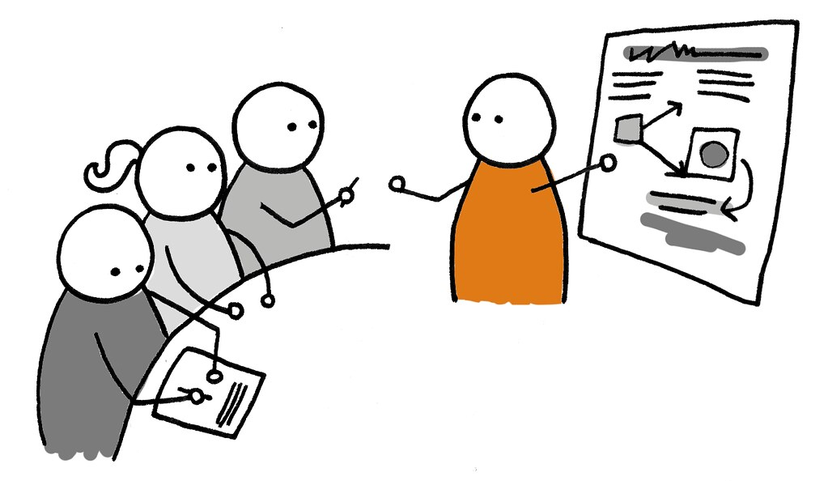
Train-the-Trainer & Mentorship
Training available “on demand” for new employees
Establish “experts” within agency
Staff learn from future mentors
Agency can infuse training with agency philosophy and expectations
Possibly provide training to other agencies (increase revenue)
Support and reward staff for becoming trainers and providing training
Notes:
Have to get training to staff quickly so they can do their jobs

Slide 29
Studies show connection between feeling competent and longevity on the job
Often staff are away from direct supervision for long periods - must be competent – must be able to have confidence in skill
Values and concepts must be repeatedly reinforced so everyone stays in sync
Studies show connection between feeling competent and longevity on the job
Often staff are away from direct supervision for long periods - must be competent – must be able to have confidence in skill
Values and concepts must be repeatedly reinforced so everyone stays in sync

Slide 30
Supporting Staff
Managers skilled in the tasks staff are performing
Field-based mentoring an essential part of the job
Staff meetings – imperative to get the staff together
Cultivating a sense of belonging

Slide 31
Maximizing Staff Meetings
Field-based – modeling inclusion
Problem solving, training, agency relationship reinforcement - a place to talk, get help, feel a part of a common cause and valued
Acknowledging success
Notes:
I always made sure to have meetings in the community at the convenience of staff. Behavior is communication. It ain’t what you say, its what you do.

Slide 32
Linking Performance to Competencies
Job Descriptions that reflect true competency needed
Performance evaluations based on competencies and real outcomes
Reviewing and setting new goals
Training to the job and the person
Reviewing and rewarding for skills and outcomes

Slide 33
Accessing Training Effectiveness Through Observations
Tie
observation to skills taught in training and competencies in job description
Avoid
Assess
training effectiveness and ability of staff. Does staff demonstrate necessary competencies
Identify
strategies to support acquisition of necessary skills
punitive feel. Associate observation to assessment of effectiveness of training
Notes:
Create list of skills taught, competencies needed. Look at performance through lens of effectiveness of training and support provided. When skill or competency not shown, work with staff to help identify what strategies will help them gain them. (ex. – SJCS staff observations as a part of evaluation of staff performance)
Example of performance eval process used at my former agency

Slide 34
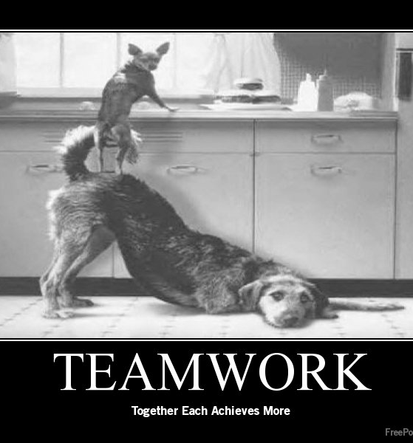
Teamwork Cooperative or coordinated effort on the part of a group of persons acting together as a team or in the interests of a common cause
Work Environment - dynamic unanticipated opportunities arise, schedules change, everything is in motion
Response – Teams form around common set of outcomes, conduct group problem-solving, share responsibility
Notes:
The other side of the coin from self-reliance. Essential in community based work. Managers must model teamwork – include team members in decision-making, problem solving, improving quality of the lives of people supported and their own work life.
Ex. Quality improvement teams

Slide 35
Team Member Characteristics
flexible and cooperative
customer service oriented
cooperates w/others to ensure appropriate support provided
Notes:
Genni

Slide 36
Supporting Teams
Train staff in group facilitation and teamwork
Encourage independent thinking – reward good work and good ideas
Be clear on parameters for team decision-making – independent vs in consultation with management
Develop some tolerance for mistakes – that’s how we grow

Slide 37
Summary
Well chosen, well trained staff are the change agents needed to help accomplish our goals
Staff recruitment, hiring and development must change as the roles of staff change
Staff training and development must be done thoughtfully and reflect the values of employment first and meaningful community inclusion
Managers must be trained differently to be the best support to field-based staff
Great teamwork is essential in community-based work

Slide 38
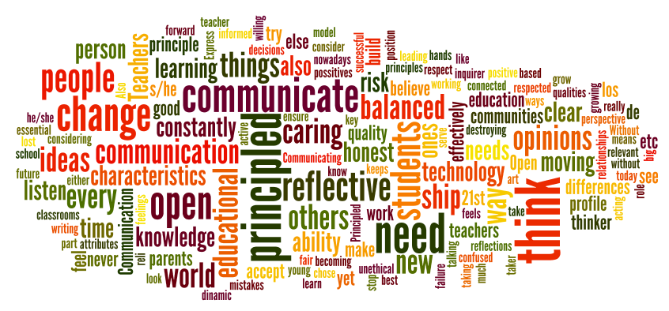
Group Discussion 1
What are some important qualities & characteristics and skills & abilities needed in community-based staff ?
Have job descriptions changed to reflect those?

Slide 39
Group Discussion 2
What techniques and strategies do you currently use to recruit quality community-based staff?
Are those strategies successful?
What could you change that may help?

Slide 40
Group Discussion 3
How does your agency get needed training for your staff currently?
Is the training sufficient?
How could you work together with other agencies or entities to get better access to quality training?

Slide 41
Group Discussion 4
How do you provide support to staff in the field?
Are your managers trained in the techniques staff are expected to use in their work?
Have manager’s job descriptions changed to include responsibility to provide support field based staff?

Slide 42
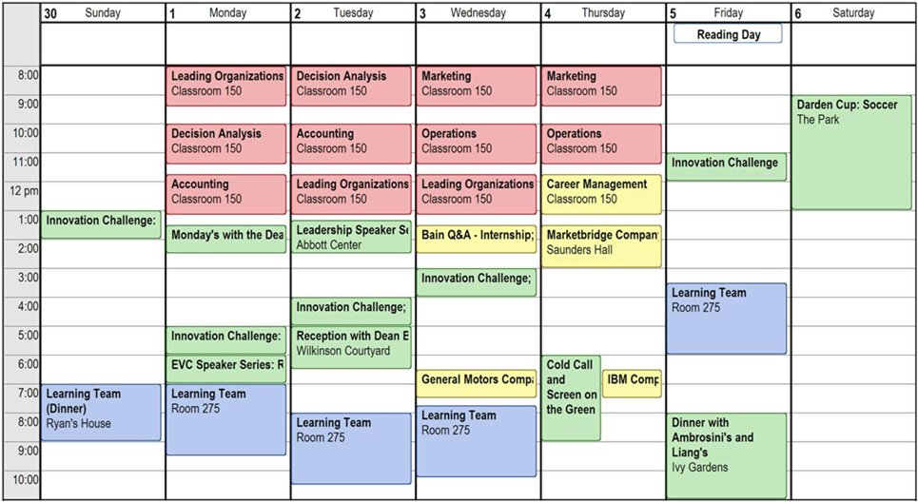
Group Discussion 4
Have you begun decentralization of your staff? Tell us about how you have done that. Do you have a specific system or method?
What is important in the deployment of community based staff?

